Slide 1
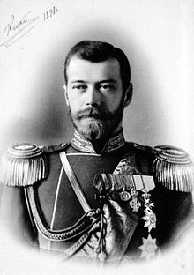
Tsar in power
Lenin’s Russia

Slide 2
Tsar-Background
At the start of the 20th Century, 1900, Nicholas II was the Tsar, and the ruler of Russia. Nicholas was an Autocrat. This meant that he had complete an absolute power. He was not elected but was born into power. He, and most other Russians, believed that he had a divine right to rule - that he had been chosen by God.
Nicholas did not need to consult with any one else to make decisions, new laws or initiate new programs of reform.
No parliament - to represent the views of the people
Tsar - power base 10% of people - aristocrats - church - military - bureaucracy
Bureaucracy - civil servants - was massive - Russia so large it was a massive task to collect taxes and run country.
Tsar censored newspapers and books
Education was via church
Okhrana - secret police - used to stop protests or opposers to Tsar’s rule
Siberia - prison camps

Slide 3
Devoted family man
Ruled by his wife - the Tsarina - a German women named Alexandra
Deeply religious
Kind to those around him yet ruthless
Anti-Jewish
Good intentions but not a born leader
No idea what the majority of Russian’s lived liked
He had no idea of the problems of his people or how to cope with them.

Slide 4
WW1
War 1914 - 1917 for Russia & 1918 for the rest of Europe
In a burst of national pride Russia united - Tsar more popular than had been for years.
United under Tsar
St Petersburg - renamed Petrograd
Tsar worked closely with the DUMA

Slide 5
WW1-Effects on soldiers
Enthusiastic at first - some initial successes
Heavy defeats
Over 1 million soldiers wounded, killed or taken prison by end of 1914 - 8 million by 1917.
Soldiers slaughtered in futile manner - soldiers had no weapons or ammunition, some soldiers had no boots and died of weather exposure - cold, or where ordered to take control of areas, after capturing them and loosing many men, they where then told to abandon.
Officers - where ineffective, not trained, had lack of equipt, poor communications between officers and different infantry groups.
High ranking officers were not military trained etc. they where aristocrat/bourgeois sons.

Slide 6
WW1-Effects on people at home
Food was short - millions of male peasants conscripted to army - food was not getting to cities - Russian trains carrying supplies to war front - reduce trains carrying food to the cities.
Coal and industry materials where short - factories closed - unemployment - people cold and hungry
Prices of food and goods continually rose
Families lost sons, brothers and husbands in the war.

Slide 7
Steps to a Revolution
1. Sept. 1915 Tsar: Nicholas II - went to the War front - BAD MOVE!!!
Tsar was now blamed for defeats
2. Handed over day to day running of country to Tsarina - German - people thought of her as a spy.
Population thought that the Tsar had handed over Russia to a German and Rasputin - coarse uneducated priest - rumors that he was evil.
3. Losing support - food situation became more desperate (huge bread cues and no bread), war casualties increased, 1916 winter was bad, railway lines iced - food & munitions to the war front, Tsarina and Rasputin in charge --- Tsar & Tsarina losing support of middle and upper class!

Slide 8
4. March 1917 -- Revolution begins -- Petrograd March 7th 40,000 workers on strike, March 8th thousands of women joined strikes (International Women’s Day)
5. Tsar order riots but put down by force -- 12th of March the SOLDIERS refused to fire on the crowds, some regiments shot their officers and joined demonstrators. Riots marched to the DUMA and demanded changes.
6. Tsar tried to get back into Petrograd - railway workers refused to let his train pass. From his train on 15th of March the Tsar abdicated.

Slide 9
Causes of the Revolution
1. Economic Causes - conditions in industry and agriculture for mass of population were appalling - low wages, low working days, little accommodation in the cities and increasingly less and less food.
2. Social Causes - living conditions of peasants and workers, October Manifesto not recognized by Tsar.
3. Political Causes - no voice for the people - DUMA - little peasant, worker representation, Tsar wasn’t running country very efficiently
4. The War - effects on the people - poor, men at work, hungry, massive slaughter and defeat, not organized, little communication, Officers did not care for soldiers well being, Tsar leaving for the front & the Tsarina being in charge, Rasputin
5. Conditions in March 1917
6. Army refused to fire on crowds

Slide 10
Provisional Government
Prov. Govt. Established on Tsar’s abdication in March 1917 - dominated by liberal minded Cadets with some
Mensheviks and SR’s. Initial changes included - amnesty for political prisoners, 8hr working day, a promise to establish a constituent assembly to discuss demands of workers and peasants, abolish special courts of secret police freedom of press, freedom of speech, the right to strike, no discrimination or death penalty.
BUT they continued with the war as to fulfill commitments to the allies and did little to solve the nation’s basic economic problems.
Provisional Govt. set up to run the country until elections could be held. Their main aims were -
to equip Russia with a constitution that would end Tsarist autocracy, to establish a law-making body with
meaningful powers and to guarantee basic rights such as freedom of speech.

Slide 11
Petrograd Soviet
The Petrograd Soviet also set up to represent the workers and soldiers- ,made up mainly of soldiers and factory workers. Insisted on checking decisions of the PG as well as issuing orders of its own. E.g. P.Soviet
They supported the creation of Constituent Assembly but opposed to the continuation of the war.
Dual Power - Prov. Govt. accepted as govt. but carry out decisions only if P.Soviet agreed.

Slide 12
Provisional Government
1. March 12th Provisional Govt. & Petrograd Soviet formed.
2. March 14th - Soviet in charge of armed forces.
3. April 16 - Lenin returns to Petrograd - Germans give him special passage - 17th of April the April Thesis published.
4. Elections - Socialist Rev. win followed closely by Mensheviks, the Bolsheviks
5. Major military offensive launched by Kerensky on Germans - terrible defeat - demonstrations in Petrograd
6. July Lenin goes into hiding - Kerensky produces letters claiming Lenin in pay by Germans - other leading Bolsheviks arrested.

Slide 13
7. Kornilov appointed head of army by Kerensky - attempted military coup by Kornilov. Kerensky panics - asks for Bolsheviks help - gives them munitions and rifles - Kornilov never came - railway workers stopped the trains and persuaded the troops not to fight. Red Guards kept their weapons.
8. Sept. 19 - Bolsheviks win control of Moscow Soviet
9. Oct. 6th - Bolsheviks win control of Petrograd Soviet
10. Oct. 23rd - Lenin returns
11. Nov 6/7 - Bolsheviks take control of Petrograd and force out the Provisional Govt

Slide 14
Why did the Provisional Government fail?
- Slowness in summoning the Constituent Assembly which the government had promised
- The continuation of the war
- Allowing political exiles to return home to Russia
-What the peasants wanted was land, the city workers wanted control of the factories. The govt. failed to realize the needs of his people. The war further discredited the govt.
- Lenin - returned and immediately called for the overthrowing of the Prov. Govt. In order to gain mass support Lenin promised - Peace, Land & Bread!
- Bolsheviks tried to take control in July but it failed.
- Kornilov Conspiracy - Bolsheviks given munitions and hailed as saviors of Petrograd

Slide 15
First Communist Government
Called ‘Council of People’s Commissars’
Lenin=President
15 Ministers
Trotsky=Minister for Foreign Affairs
Joseph Stalin=Commissar of Nationalities

Slide 16
Establishing a New Government
Called a Ceasefire with Germany
Land distributed to peasants
Nationalisations: banks and factories now belonged to the state
Workers had a say in factory production
Revolutionary tribunals replaced normal courts
However the Bolsheviks only received a quarter of votes in the election for Constituent Assembly (body of citizens put together to draft a constitution)

Slide 17
SR’s won the majority of the votes. They represented the peasant support in rural areas, which made up 80% of the population.
Bolshevik support came from soldiers and workers in the cities.
Lenin did not want to share power.
Jan 1918 Petrograd Soviet were shot at as they marched to support the Constituent assembly.
Assembly was closed and meetings held in secret.

Slide 18
Russian Constituent Assembly Election Nov 1917
Party Votes Number of deputies
Socialist Revolutionaries 370
Bolsheviks 175
Mensheviks 15
Kadets 17
SR’s 40
National Parties 86
Other 47

Slide 19
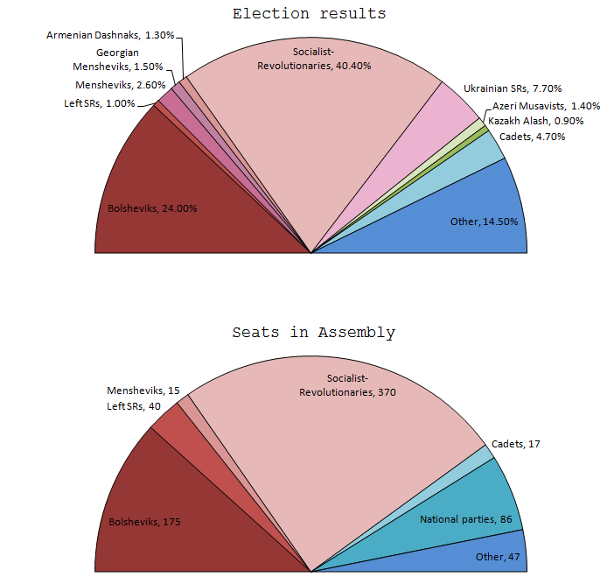

Slide 20
Russian Civil War 1918-1921
Russians were unhappy with the Treaty of Brest Litovsk. It pulled Russia out of the war but Russia gave up land which contained 80% of their Iron, 90% of their coal along with one-third of its population
This discontent among Russians led to the out break of the Civil War

Slide 21
Russian Civil War 1918-1921
1. Bolsheviks (later called Communists or the Reds) were led by Lenin and Trotsky
- Lenin organised economic and political areas
- Trotsky organised the military (Red army)
2. The Bolsheviks were opposed by the Whites
- These were composed of many different groups (Tsarists,landlords,industrialists)
- They were helped by Allied Powers while the war was still on

Slide 22
Russian Civil War 1918-1921
3. Lenin organised ‘War Communism’ which ensured that all industry and agriculture were geared to the war
4. Reds organised the ‘Red Terror’. Anybody accused of co-operating with the Whites were punished and executed by Cheka.

Slide 23
Why did Lenin & Trotsky win the war?
They provided a united leadership.
The White armies were divided and cruel to the people in the countryside
Trotsky enforced discipline. Conscription introduced. Brought in Tsarist soldiers to out number the Whites. Tsarist officers were used to train soldiers.
They used Propaganda that made people fear the return of Tsar and landlords
The Red Terror put down opposition
Allies withdrew from Russia and did not provide supplies for the Whites

Slide 24
Red Terror
The attempted assassination of Lenin started the Red Terror
This involved punishment or execution of anybody accused of co-operating with the Whites
Cheka were led by Felix Dzerzhinsky
Tsar family murdered by the Reds
Mass executions based on class and beliefs
It was the Communists way of establishing complete control through fear and terror.
1st Concentration camps were established.

Slide 25
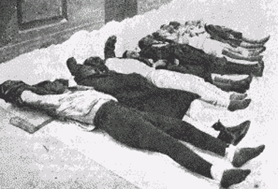

Slide 26
Different punishments
‘Eyes poked out, tongues cut out, ears and noses cut off’
‘People placed in rows and their hands were nailed to tables’
‘Cuts around their wrists were made with a knife, poured boiling water over their hands and pulled the skin off’
‘Victim’s heads were placed in an Anvil and slowly crushed’ with a sledge hammer. Victims undergoing the same punishment the following day were made watch’
‘People buried alive’
‘Stomachs were cut open and intestines pulled out which were then nailed to a telephone pole, then person was then forced to run around the pole until intestine had unravelled’

Slide 27
‘One bishop was burnt alive is a big pot and his monks were forced with a gun to their head to drink the soup’
‘People placed in barrels with nails facing inwards and then rolled down hills’
‘Hands of victims were sawn off’
‘Some victims were buried alive with decomposing bodies beside them’

Slide 28
War Communism
This was a new policy introduced by the communist government that involved replacing private businesses with state control over farms, factories, railways and shops.
- Workers no longer had control of factories
- Privately run businesses were illegal
- Food was rationed
- Forced labour was introduced
All industry and agriculture was geared towards the war

Slide 29
War Communism
This attempt to introduce full blown Communism led to the collapse of the Russian economy
- money was worthless
- prices rising out of control
- peasant refused to sell grain to the government
- the Cheka and Red Army ere sent to the countryside to seize the grain. Many peasants were killed.
- Lack of food and bad weather led to a famine where 5 million died
- International aid was sought to help the Russians

Slide 30
New Economic Policy NEP
1. The soviet economy was in a bad state by 1921, due to WWI, Civil War and War Communism.
2. Sailors in Kronstadt naval base revolted against Communist Party and War Communism. Lenin and Trotsky ordered the Red Army to put down the rebellion
3. Lenin decided to change economic policy. He introduced New Economic Policy

Slide 31
NEP
4. The main points were:
- taking of food from peasants ended
- there was a fixed tax (grain)
- peasants could sell their surplus produce
- private enterprise was allowed in small industries
- heavy industry (coal,iron,electricity) was controlled by the government

Slide 32
5. NEP was successful:
-industrial and agricultural production rose
-rich peasants benefited
-Lenin and the Communists survived

Slide 33
Rule of Lenin
Lenin and the Bolsheviks (communists/reds) took over Russia in October 1917. They held on to power by setting up the Cheka (secret police) and making peace with Germany in WW1 (Treaty of Brest-Litovsk)
The Russian Civil War 1918-21
Lenin organised economic and political areas
Trotsky organised the military
The Bolsheviks were opposed by the Whites who were helped by the Allies (US, Britain and France) but their effort was half-hearted
Lenin organised War Communism- all industry (factories taken over by the government and strikes banned) and agriculture (surplus crops taken by the government and food was rationed) were geared towards the war.
Lenin also organised the Red Terror. Anyone against the Reds was punished or executed.
Lenin and Trotsky won because they provided a united leadership/conscription was organised/the White army was divided/used propaganda/used terror

Slide 34
New Economic Policy NEP
1. The soviet economy was in a bad state by 1921, due to WWI, Civil War and War Communism.
2. Sailors in Kronstadt naval base revolted against Communist Party and War Communism. Lenin and Trotsky ordered the Red Army to put down the rebellion
3. Lenin decided to change economic policy. He introduced New Economic Policy
4. The main points were: taking of food from the peasants was ended/peasants could keep their surplus produce/private enterprises were allowed/government controlled heavy industry
5. It was a success because industrial and agricultural production rose/rich peasants (kulaks) benefited

Slide 35
6. Lenin died in 1924 after a series of strokes
A cult of Lenin developed after his death
- he had a huge influence on history of Russia
- he created the Communist Party
- he led a successful revolution when the Bolsheviks took power in October Revolution 1917
- He ensured the survival of communism by making peace with Germany in WWI and by winning the Civil War
- He created one party communist dictatorship

Slide 36
How did Lenin and Stalin transform the Economy and Society of the USSR?

